Slide 1
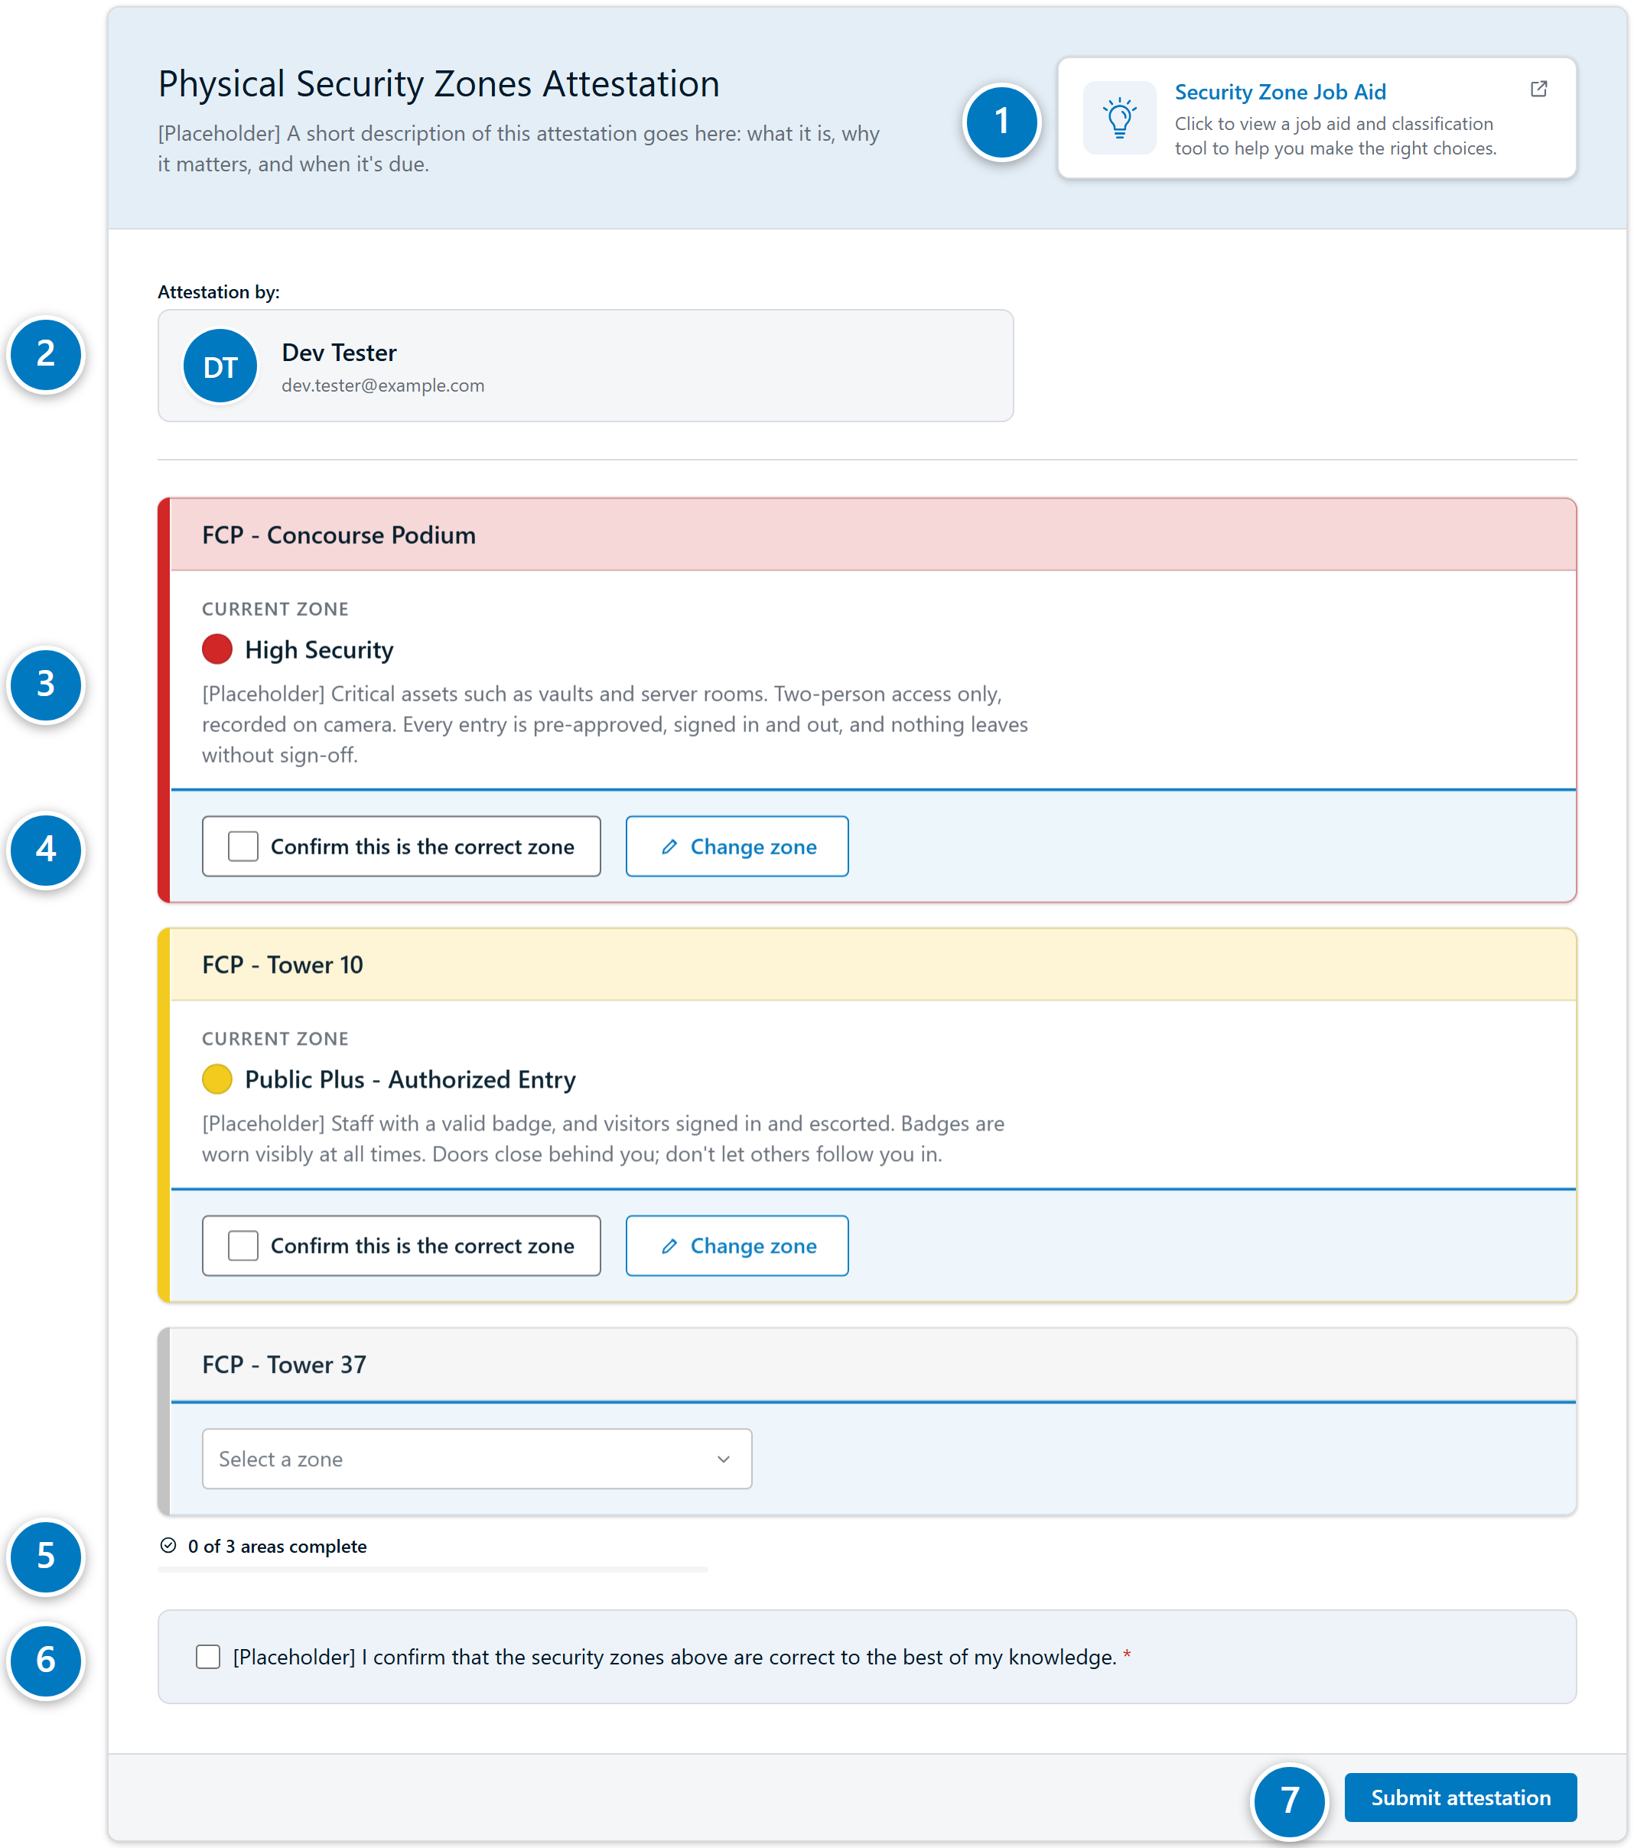

What people see when they open the form
1
A link to the job aid
2
Who is attesting
3
One card per assigned area, showing its current zone
4
What to do for that area, highlighted in blue until answered
5
Progress across all their areas
6
One final statement to tick
7
Submit
Internal 1
Notes:
This is the whole form as a person first sees it. They only ever see their own areas. Each area is a card with the zone on file; the blue band on each card is what they need to do. Two areas here have a zone on file; the third, Tower 37, has none yet.

Slide 2
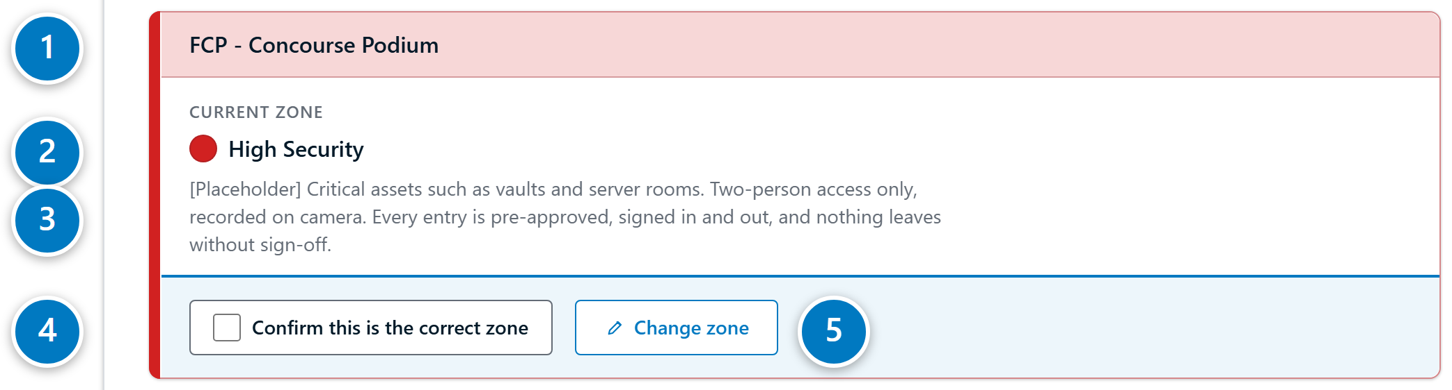
Each area shows its zone and two choices
1
The area, tinted in its zone's colour
2
The zone on file
3
What that zone means
4
Confirm it is correct
5
Or change it
Internal 2
Notes:
Up close, one card. The header takes the colour of the zone, the zone is named with its colour dot, and the description says what the zone means. The person has exactly two choices: confirm it, or change it.

Slide 3
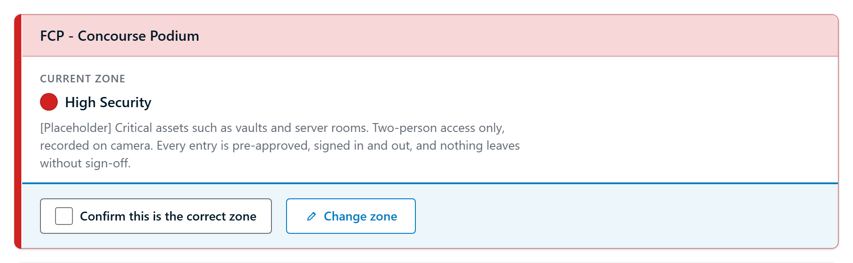
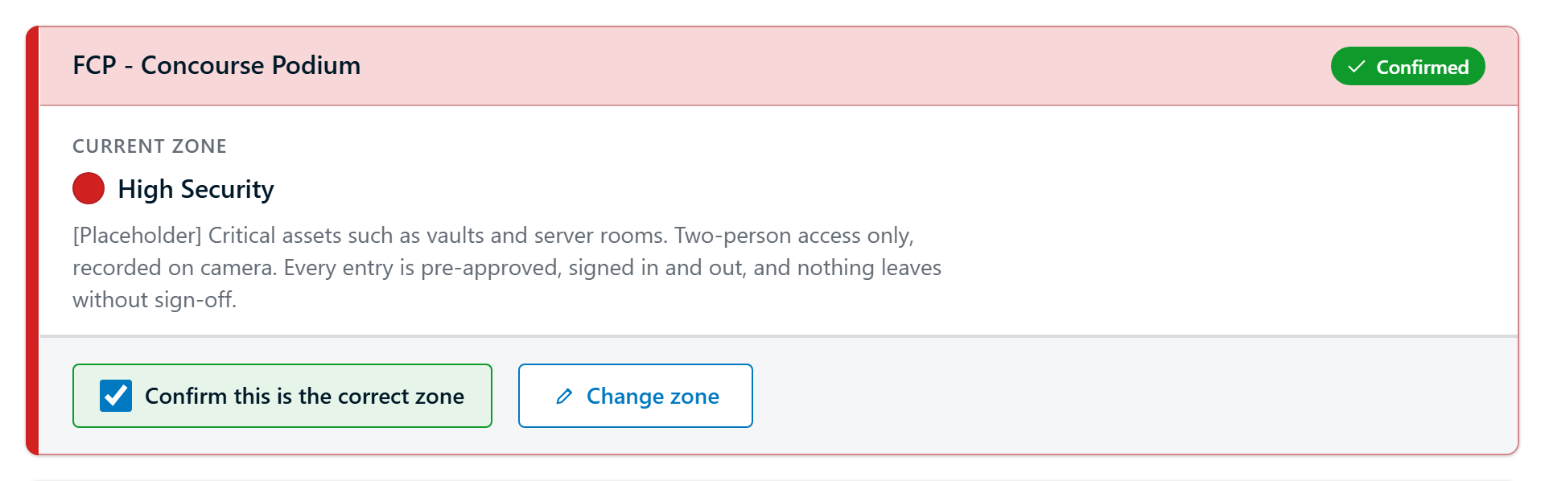
If the zone is right, one tick confirms it
Before
After
Green box, a Confirmed badge, and the blue band settles to grey.
Internal 3
Notes:
Most areas will be this simple. One tick and the card shows it is done. Unticking puts it back.

Slide 4
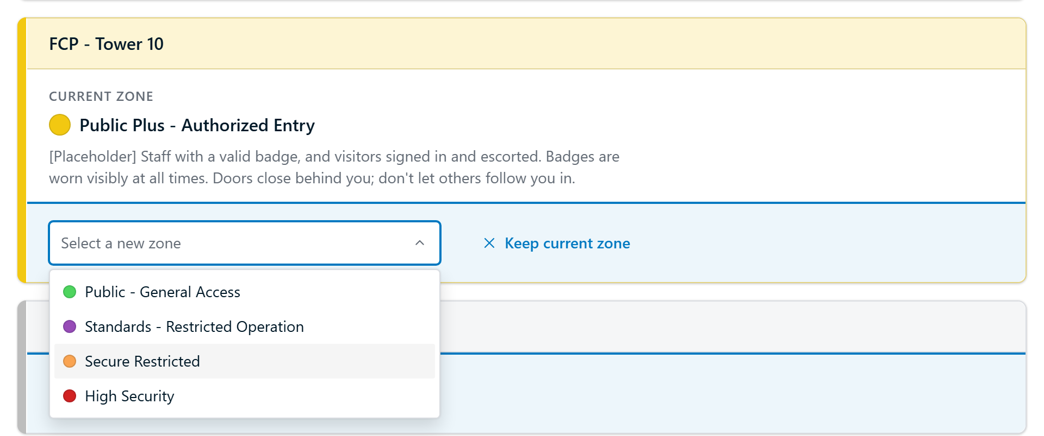
If it's wrong, Change zone lists the other four
The current zone is left out of the list. Keep current zone is right there if they change their mind.
Internal 4
Notes:
Tower 10 is on file as Public Plus, but the person knows it is wrong. Clicking Change zone swaps the button for the zone list, already open.

Slide 5
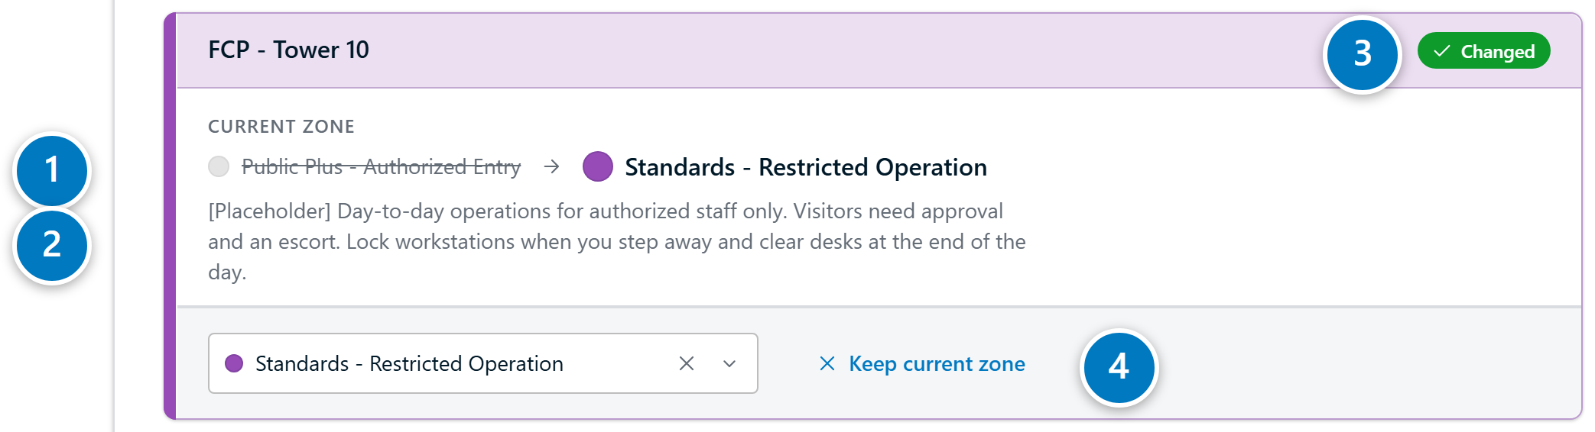
The new zone and its rules show before anything is saved
1
Old zone greyed out and struck through, new zone beside it
2
The new zone's description replaces the old one
3
Marked as changed, in the new zone's colour
4
Keep current zone undoes the change
Internal 5
Notes:
After picking Standards, the card makes the change obvious: the old zone is struck through, the arrow points to the new one, and the person reads the Standards rules before they submit.

Slide 6
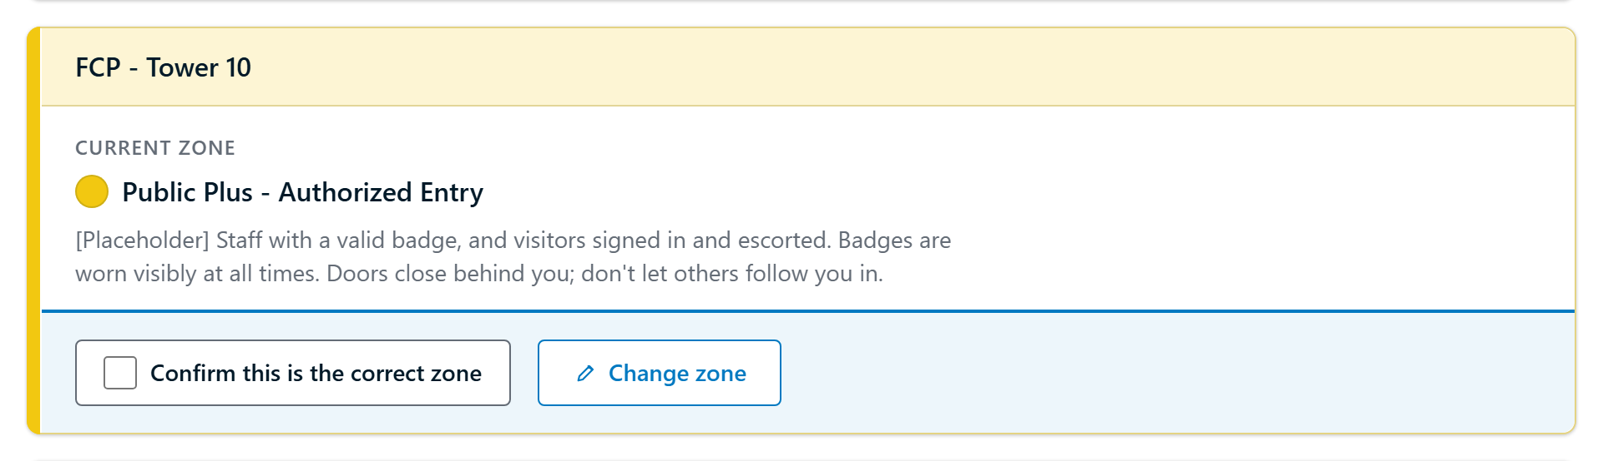
Keep current zone puts the area back as it was
Changed to Standards
After Keep current zone
Back to the zone on file, still waiting to be confirmed.
Internal 6
Notes:
If they change their mind, Keep current zone restores the card exactly as it started. It does not confirm it for them; they still tick the box.

Slide 7
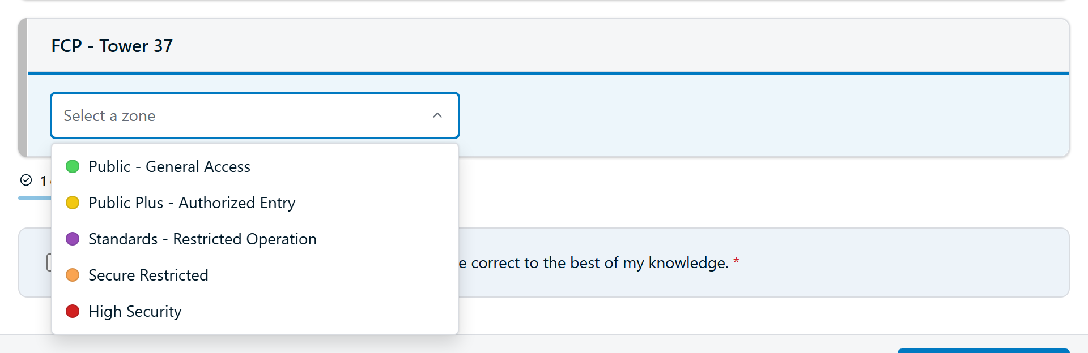
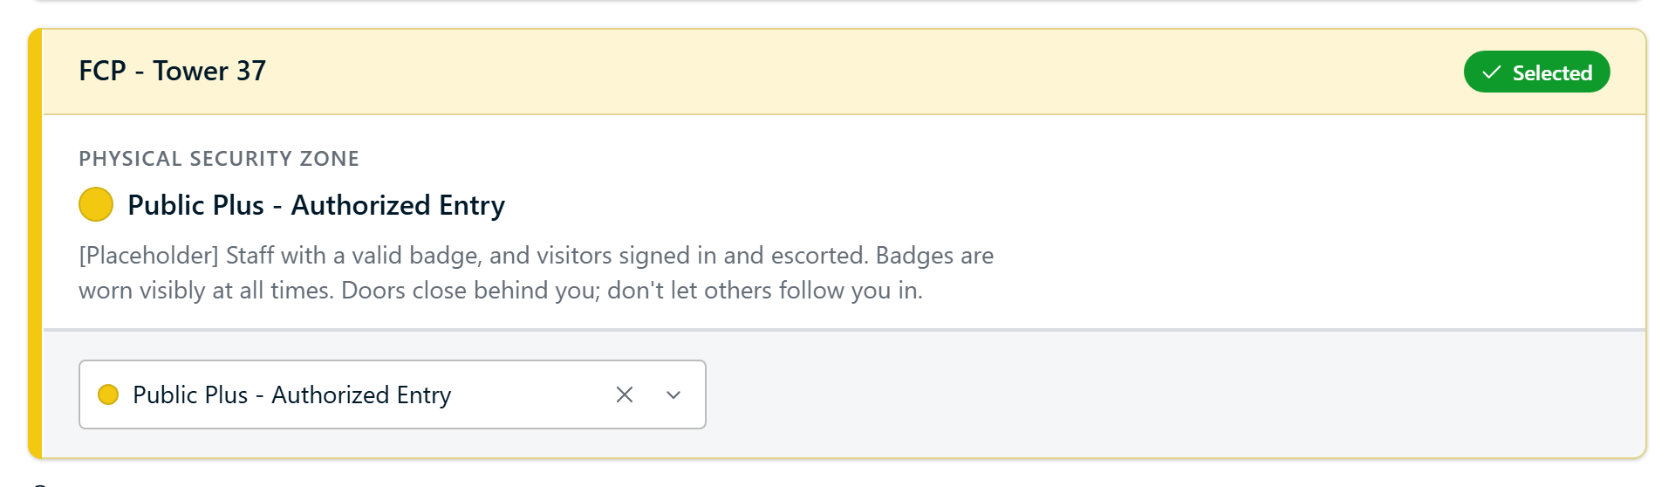
An area with no zone on file goes straight to the list
Nothing to confirm
All five zones are offered.
After choosing
The zone's meaning appears, and the card takes its colour.
Internal 7
Notes:
Tower 37 has no zone on file yet, so there is nothing to confirm. The card opens with the zone list instead.

Slide 8
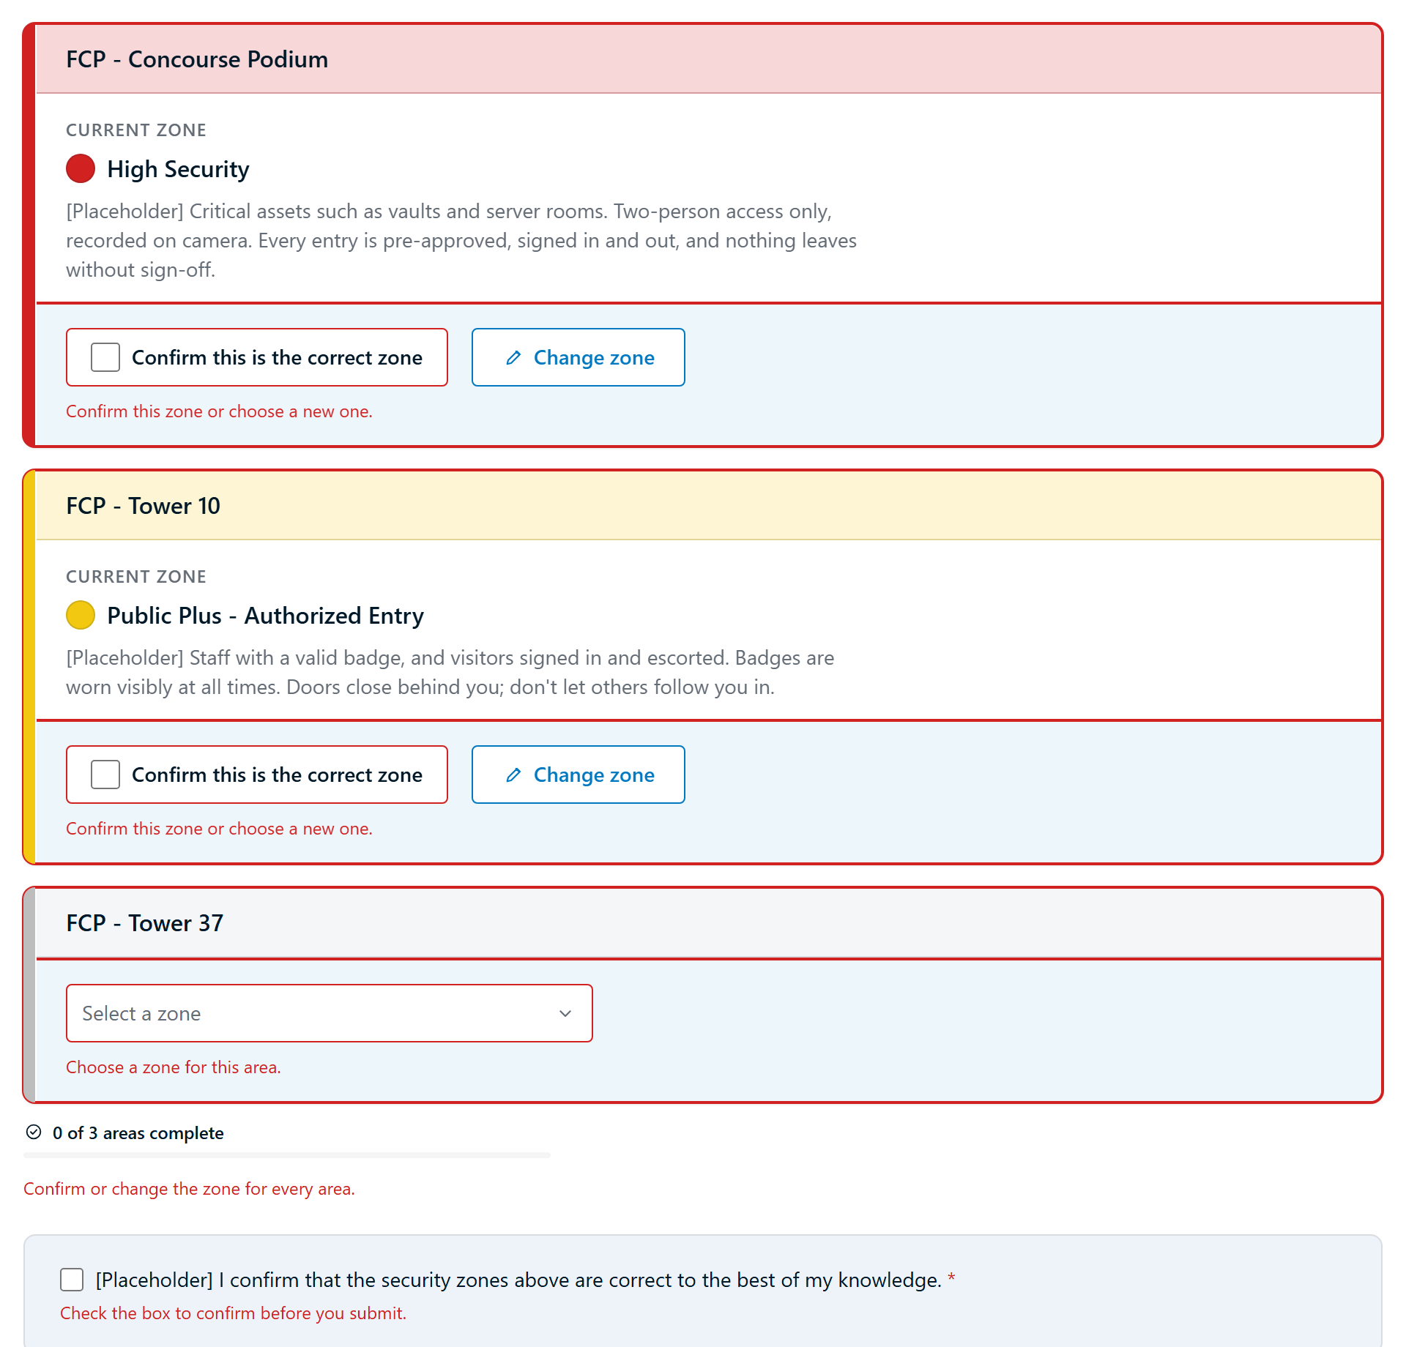
Anything missed is flagged before submitting
Each unanswered area turns red and says what it needs. The final statement has to be ticked too.
Internal 8
Notes:
If someone clicks Submit too early, nothing is sent. Every area still needing an answer is outlined in red with its own message, and the cursor jumps to the first one.

Slide 9
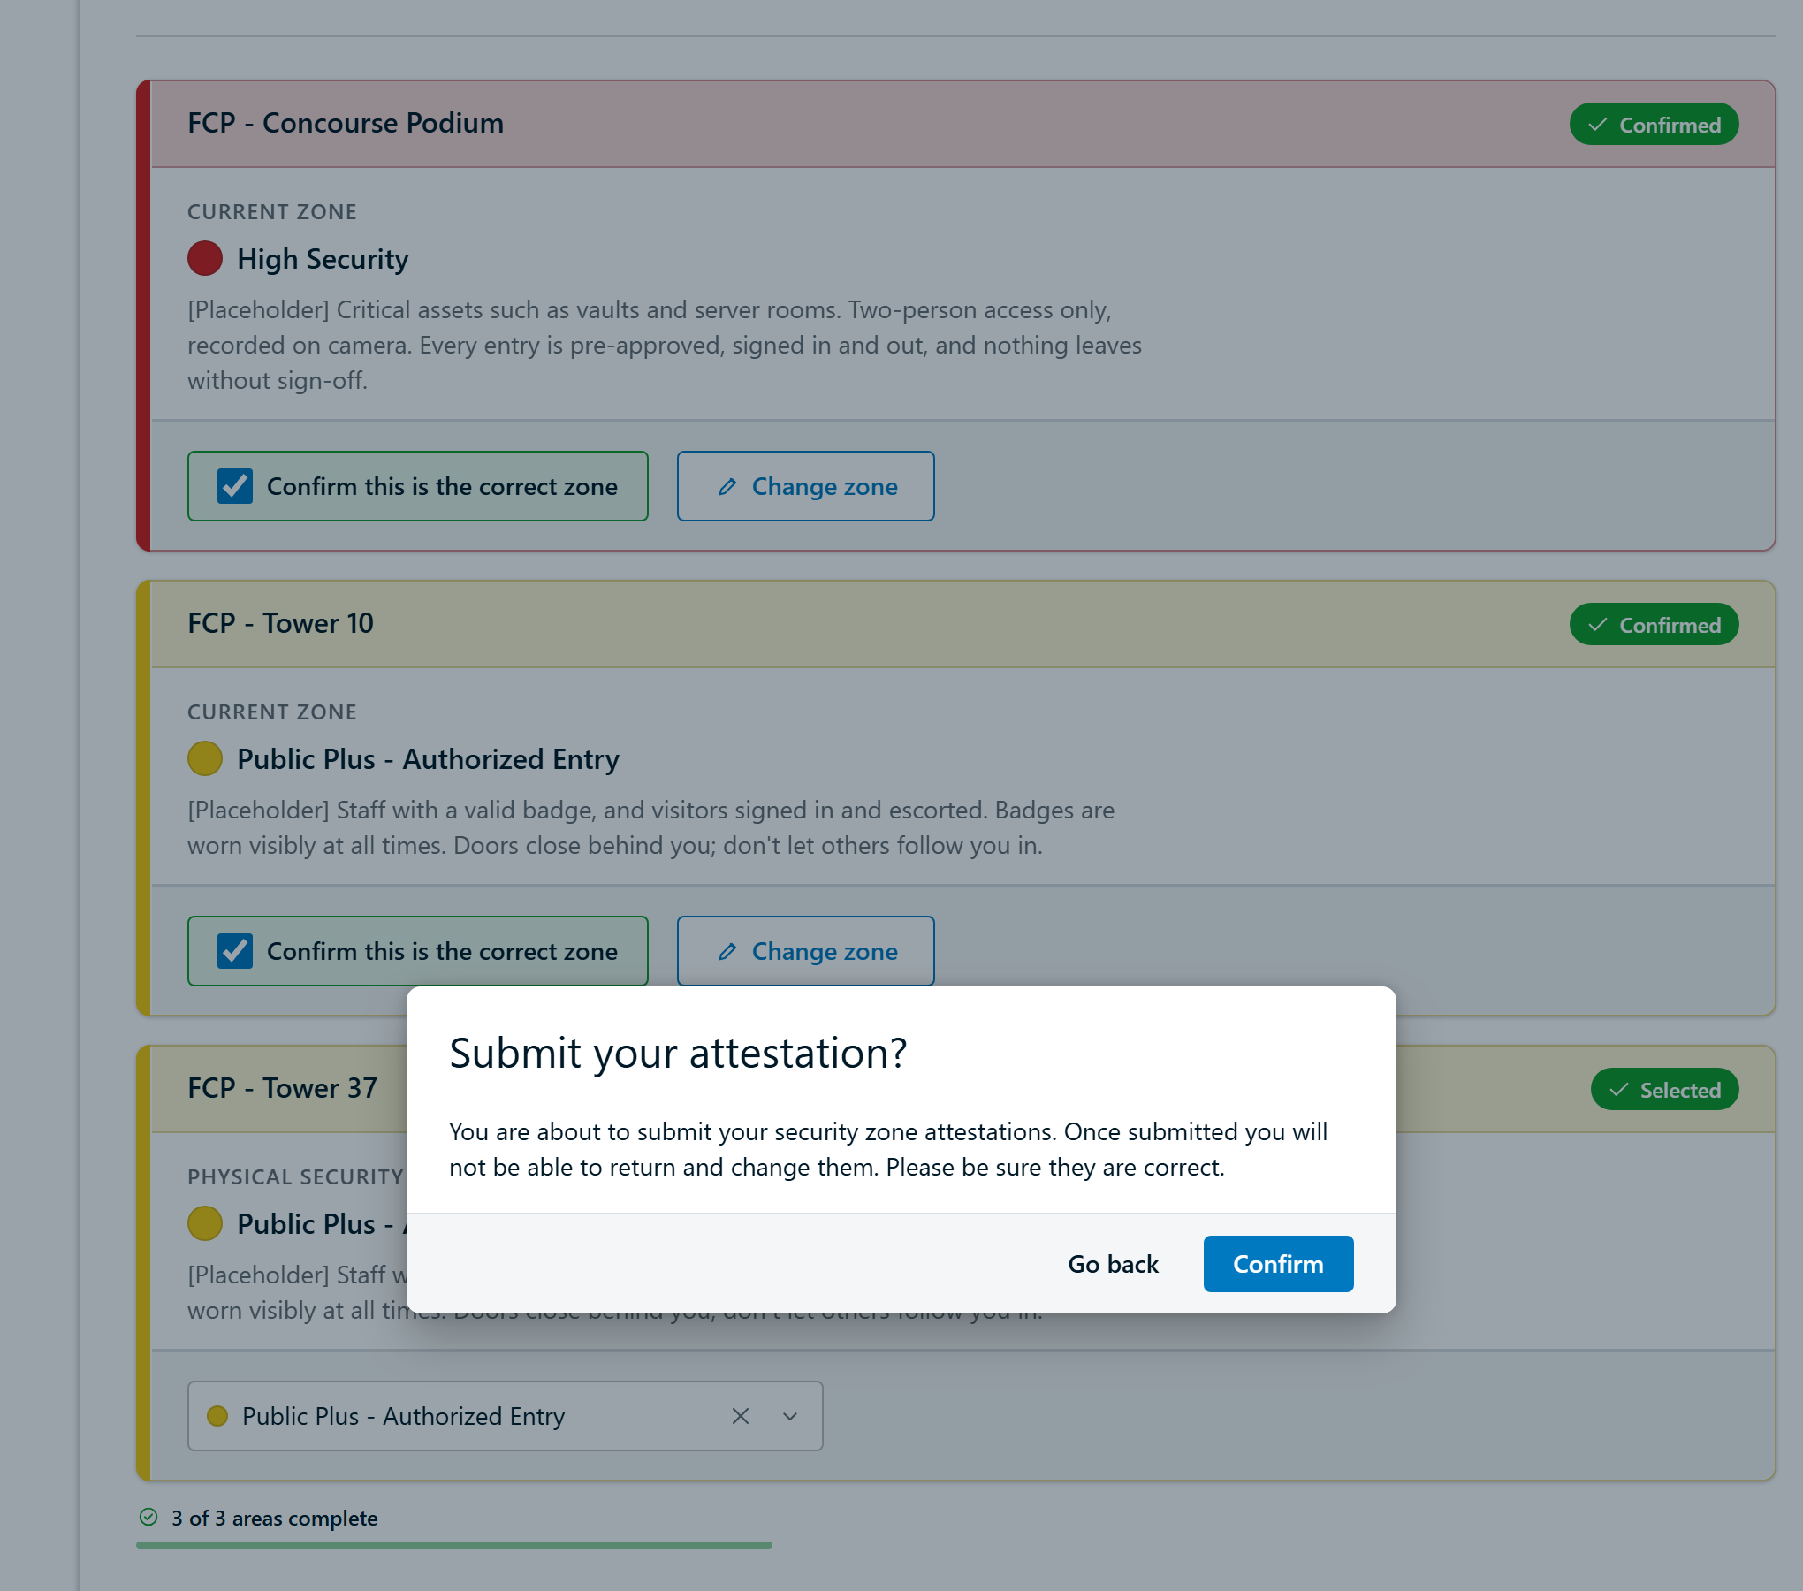
One last check before the answers are final
Every area is answered, so Submit asks once more. Go back returns to the form.
Internal 9
Notes:
With everything answered, every card wears a badge: Confirmed, Changed or Selected. Submit opens this dialog because answers cannot be changed afterwards.

Slide 10
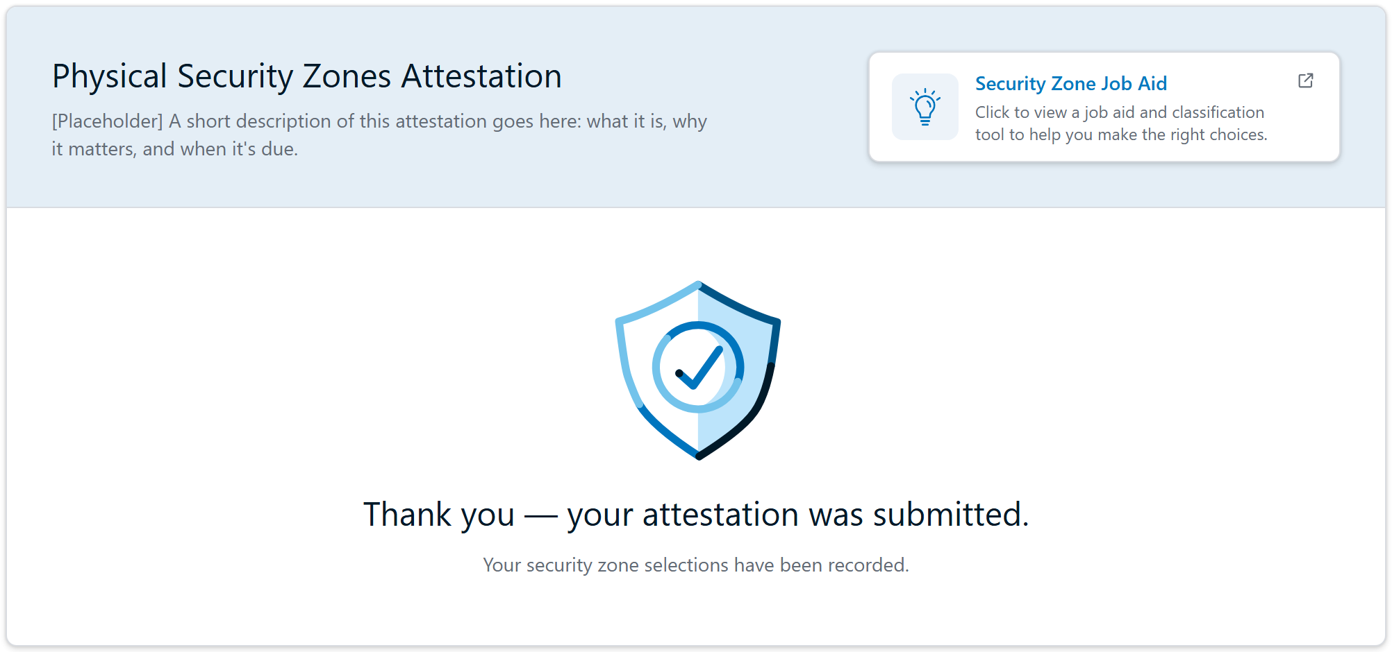
Then a clear thank-you
Internal 10
Notes:
The form is replaced by a confirmation that the attestation was recorded.

Slide 11
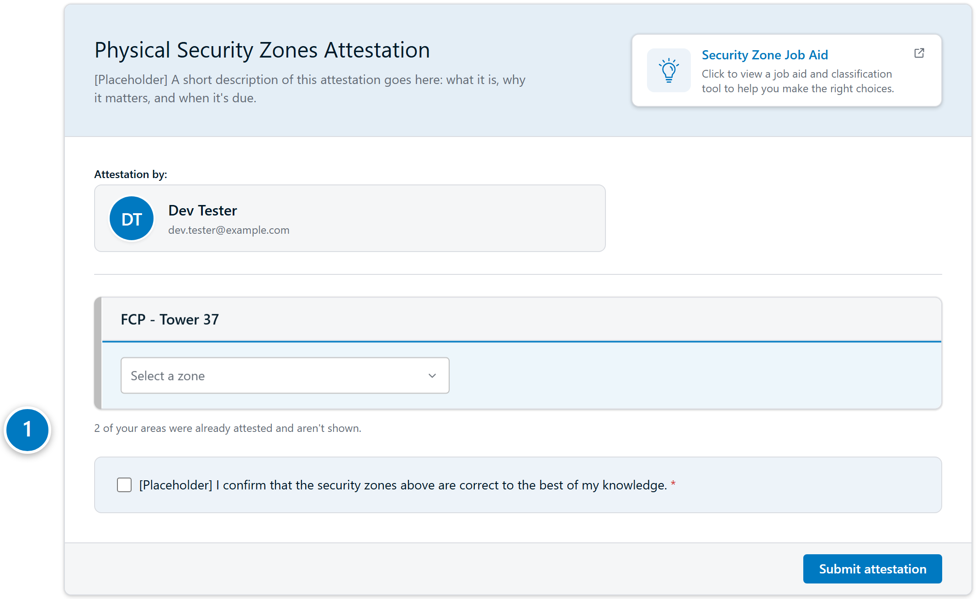
Coming back later shows only what's left
1
A note says how many areas are already done
Internal 11
Notes:
Areas already submitted drop off the form, so a person who comes back sees only what is still missing.

Slide 12
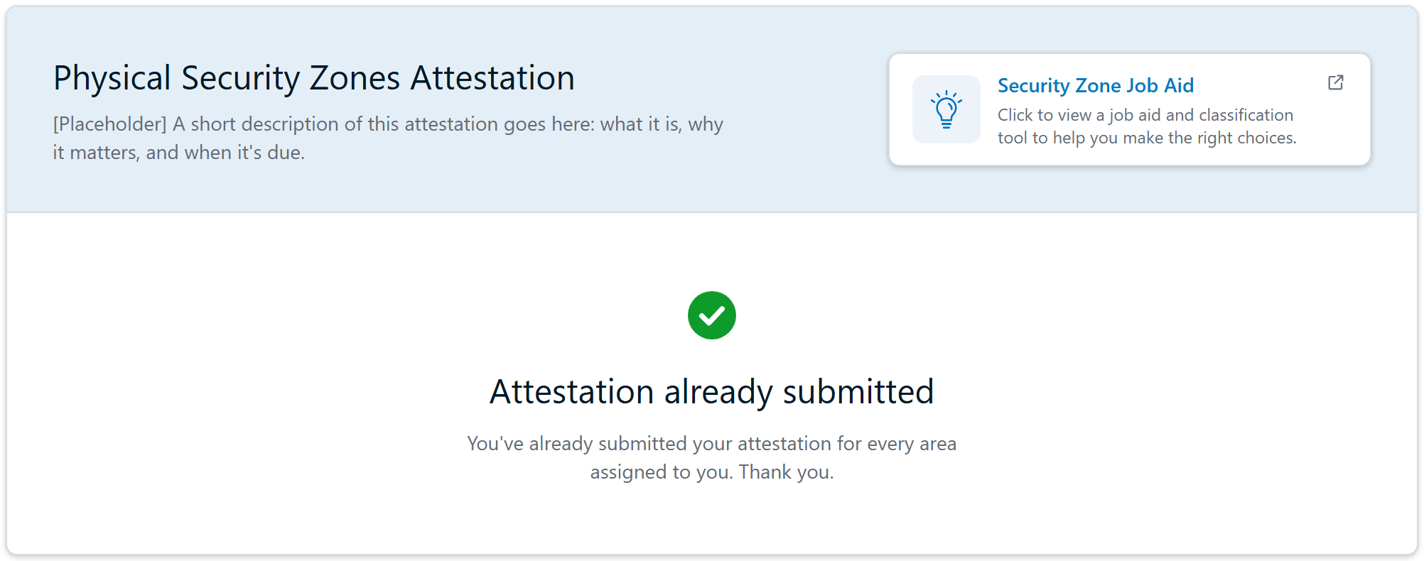
When everything is submitted, the form says so
Internal 12
Notes:
Someone who has already attested every area sees this instead of the form.

